Slide 1
The Horizon Simulation Framework
Eric Mehiel (Dr. M. or Sim Master Mehiel)
(he/him/his – ally)

Slide 2
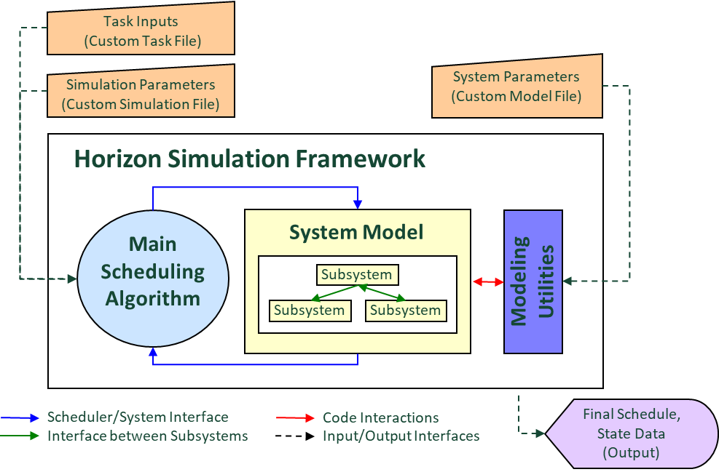
Motivation
How do you verify a system level requirement?
Many system level requirements are ‘use’ based
How much utility will the user of the system get out of the operational system?
Use Dynamics Programing and Discrete Event Simulation (with a touch of Agent Based Modeling)
The Horizon Simulation Framework was created to solve these kinds of problems
Combines a scheduling component with a modeling component

Slide 3
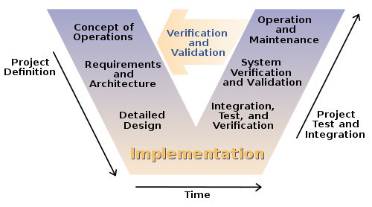
What problem is HSF trying to solve?
Verification and Validation of System Level Requirements can be difficult if the system is not operational
"Systems Engineering Process II" by Leon Osborne, Jeffrey Brummond, Robert Hart, Mohsen (Moe) Zarean Ph.D., P.E, Steven Conger https://commons.wikimedia.org/wiki/File:Systems_Engineering_Process_II.svg#/media/File:Systems_Engineering_Process_II.svg
Notes:
Main system level requirements can best be verified by simulation (Utility or Use Requirements)
Attack the problem by developing a model of the system that, when exercised, will simulate the behavior of the system over time

Slide 4
What is HSF?
Task Inputs
(Custom Task File)
Simulation Parameters (Custom Simulation File)
System Parameters (Custom Model File)
Horizon Simulation Framework
System Model
Modeling Utilities
Main Scheduling Algorithm
Subsystem
Subsystem
Subsystem
Scheduler/System Interface
Code Interactions
Final Schedule, State Data (Output)
Interface between Subsystems
Input/Output Interfaces
Notes:
A library of integrated software tools supporting rapid system-of-systems modeling, simulation and utility analysis
Provides an extensible and well-defined modeling capability concurrent with a scheduling engine to generate operational schedules of Systems-of-Systems with corresponding state data
Modular, Flexible with built-in utilities

Slide 5
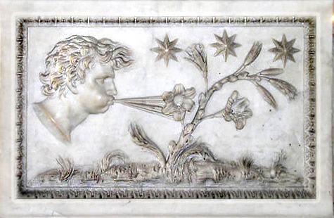
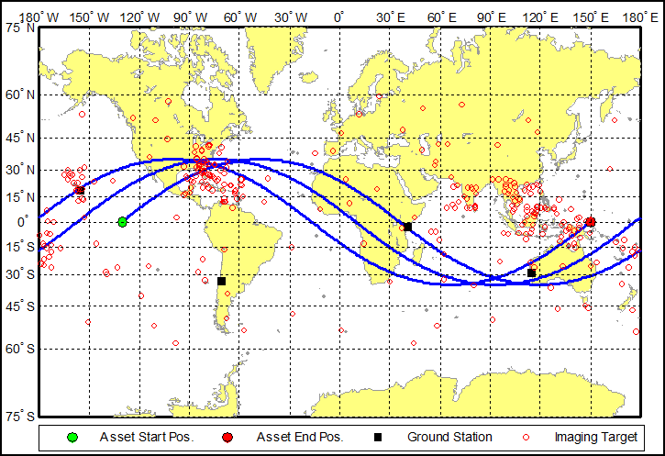
Example HSF Mission
Aeolus: The Greek ruler of wind
Extreme-weather imaging satellite
Circular, 1000km, 35 degree inclined orbit
Simulation date: August 1st 2008 for 3 revolutions
Targets clustered into high-risk areas, including Southeast Asia and the Gulf of Mexico
Sensor has ability to generate data while in eclipse
A rev-in-the-life of the Aeolus constellation
Notes:
Aeolus Test Case – Rev. In The Life used to verify a utility based system-level requirement

Slide 6
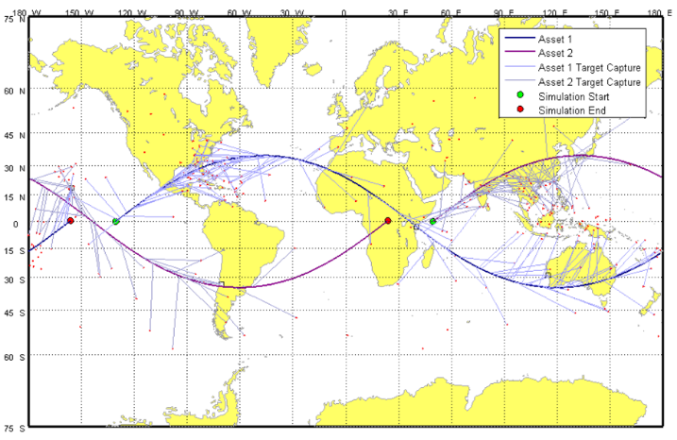
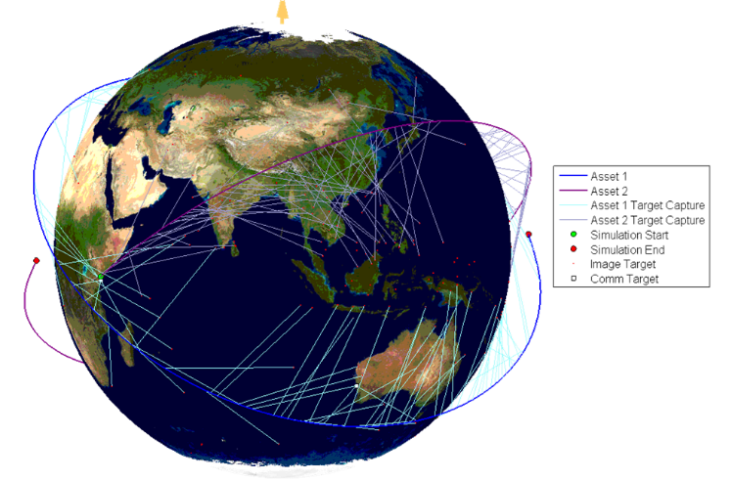
The Aeolus Results: Visualization
Matlab visualization of HSF simulation results

Slide 7
The Aeolus Model
ADCS
Actuates spacecraft to target in user defined slew time
EO Sensor
Takes data in user defined low, medium or high resolution (number of pixels)
SSDR
Records data in user defined storage buffer
COMM
Downlinks data at user defined downlink rate
Power
Maintains depth of discharge information from subsystem power usage and solar panel power in

Slide 8
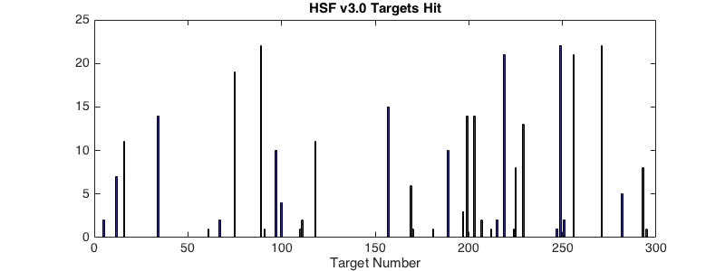
v3.0 Targets Imaged
307 Hits

Slide 9
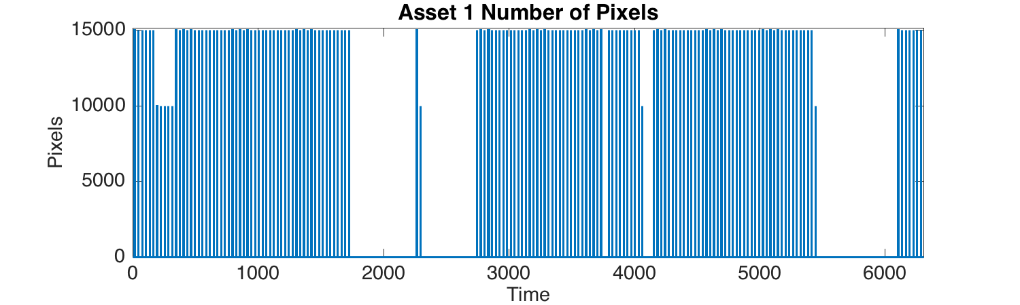
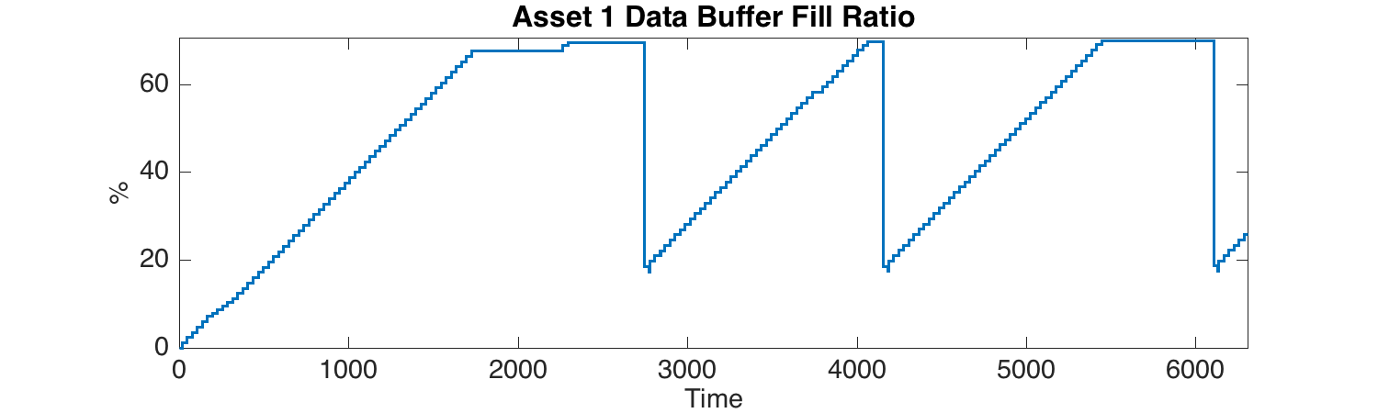
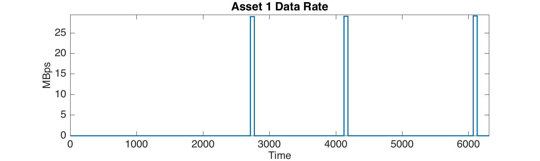
Asset 1 Data

Slide 10
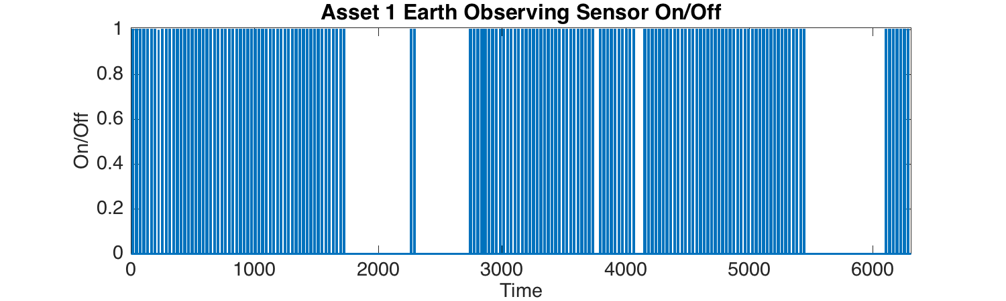
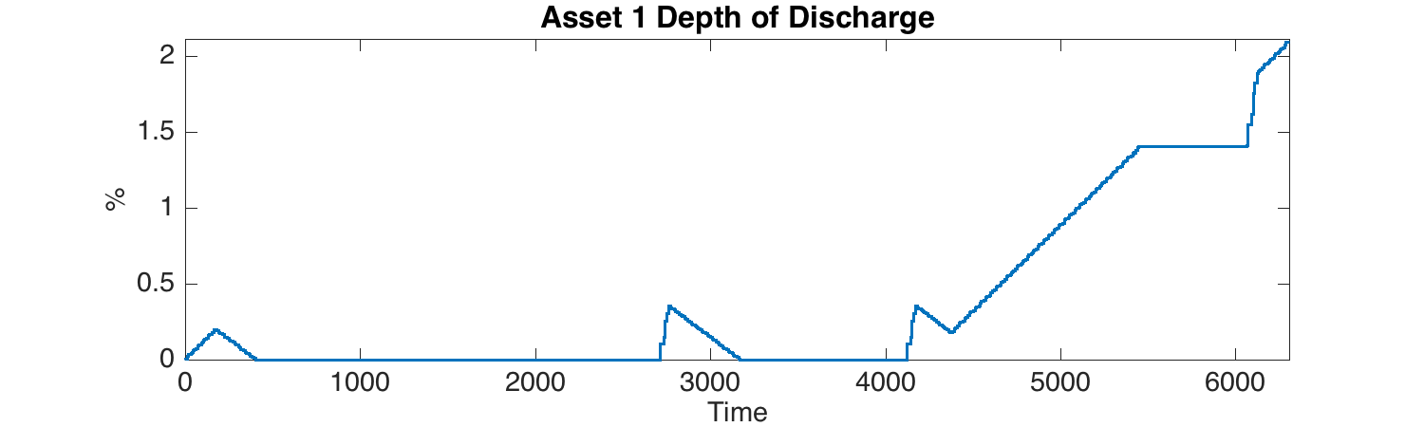
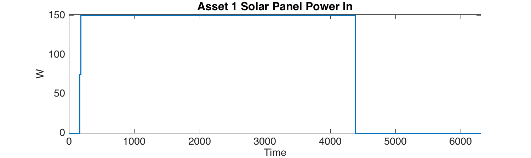
Asset 1 Data

Slide 11
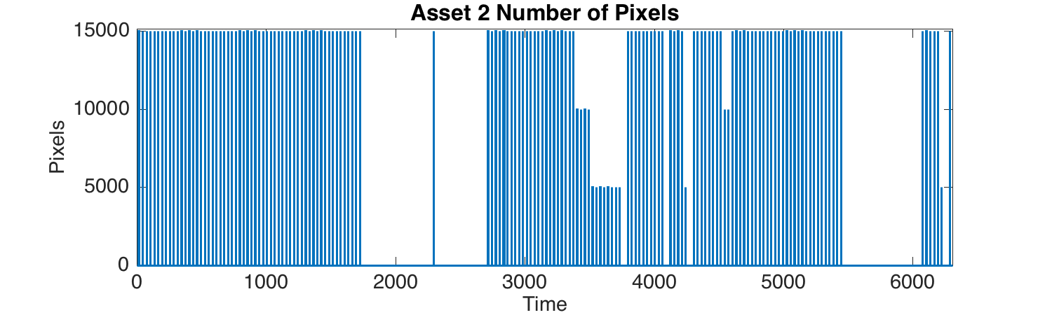
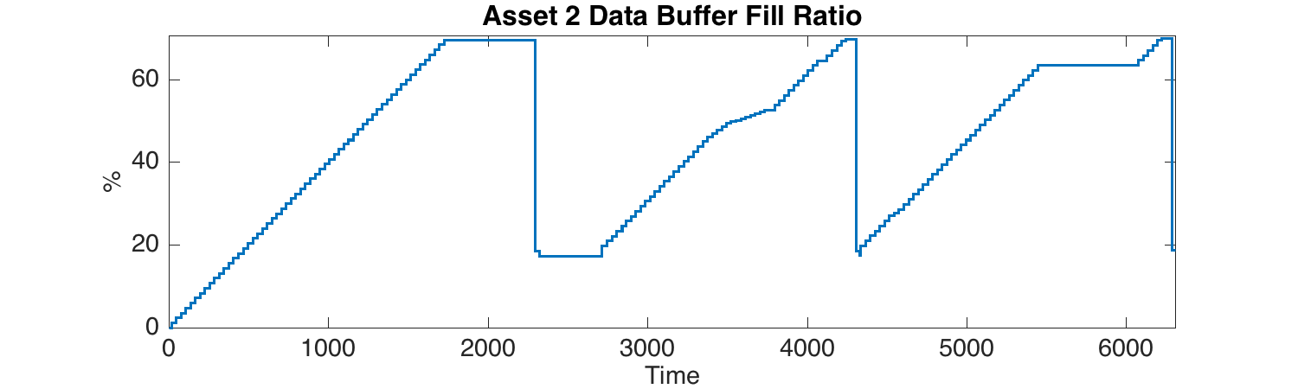
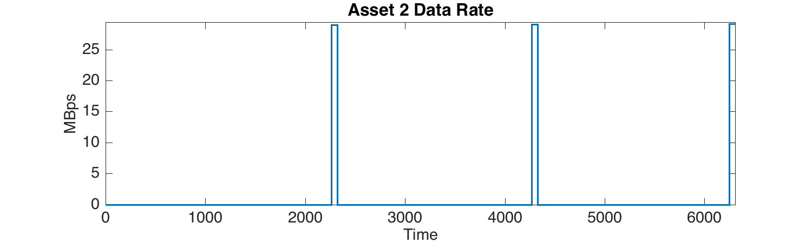
Asset 2 Data

Slide 12
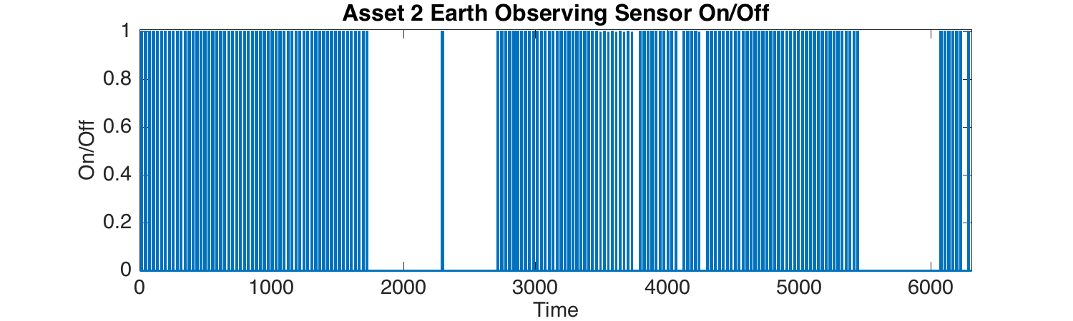
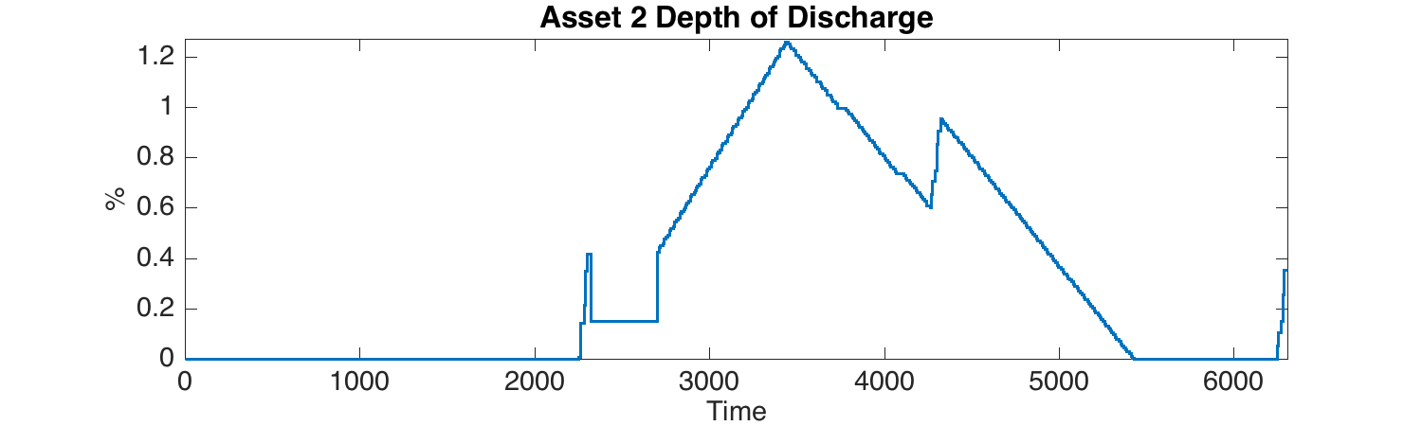
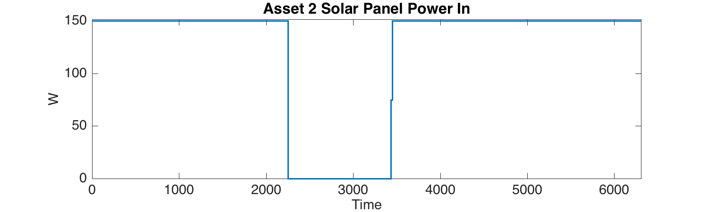
Asset 2 Data

Slide 13
How Does Horizon Work?
HSF is a hybrid Discrete Event Simulator, except…
HSF uses Dynamic Programming to search the multiverse of possible schedules that can be generated
HSF uses a constant time advance function to search for possible tasks to schedule
In this case, tasks are allowed to start any time within an ‘Access’ window
Once a task start time is determined, a new event is proposed for scheduling
The scheduler passes a current schedule and proposed event (a task at a time) to the system model for evaluation
The model acts as a state transition function
The details of how the model works is defined by the user, hence almost any system model can be used in HSF
Even Agent Based Models

Slide 14
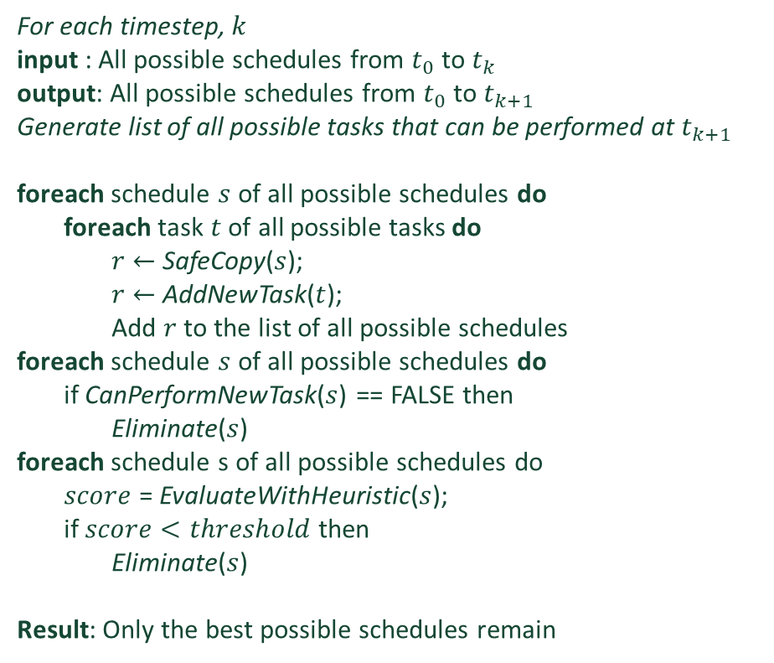
HSF Algorithm
For each timestep, $k$
input : All possible schedules from $t_{0}$ to $t_{k}$
output: All possible schedules from $t_{0}$ to $t_{k+1}$
Generate list of all possible tasks that can be performed at $t_{k+1}$
foreach schedule $s$ of all possible schedules do
foreach task $t$ of all possible tasks do
$r←$SafeCopy($s$);
$r←$AddNewTask($t$);
Add $r$ to the list of all possible schedules
foreach schedule $s$ of all possible schedules do
if CanPerformNewTask($s$) == FALSE then
Eliminate($s$)
foreach schedule s of all possible schedules do
$score$ = EvaluateWithHeuristic($s$);
if $score<threshold$then
Eliminate($s$)
Result: Only the best possible schedules remain
A hybrid Discrete Event Simulator with Multiverse generation using Dynamic Programming

Slide 15
Key functions within Algorithm
AddNewTask(s)
CanPerformNewTask(t)
EvaluateWithHeuristics(s)
Only returns true if proposed schedule is not busy.
The task cannot start before the last event is finished
Proposed task/schedule combo is deconflicted in time
Only returns true if the whole model of the system can complete the task while maintaining state integrity
State integrity is determined by the model as a state transition function
Proposed task/schedule combo is deconflicted in state
After proposed task/schedule combos (new schedules) are created
Determine the ‘score’ of a schedule based on satisfying some user requirement
Use HSF to find sufficient schedules

Slide 16
A Few Definitions
Scheduling Elements
Task – A task is the goal of an asset at each simulation time step. It consists of a target and the type of action to be performed at the target.
State – The state is a system level dictionary of the current state of the subsystems . Each subsystem has a key that allows them to access their state information from the high-level catalog. The time history of the state throughout the simulation time is maintained in a chronological collection of states.
Dynamic State – The dynamic state is an element specialized for maintaining information about the dynamics, such as position and velocity, of the system.
Event – An event is the combination of a task and state. For every simulation time step there is one event, and a task may be scheduled at any point within an event.
Schedule – A schedule is simply a chronological collection of events. The tasks within every event are proposed to the system and only the schedules that can be performed are output by the simulation.

Slide 17
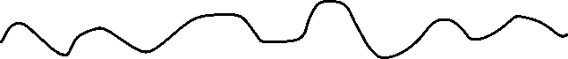
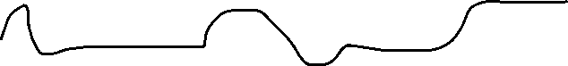
Scheduling Elements
Schedule
Event 1
Event 2
Event N
…
Task 23
Task 42
Task 342
State,
power
Dynamic State,
position
Time

Slide 18
Why Time Advance with DES?
This comes from the initial problem we were trying to solve
Each Task can happen during an Access
Originally, an access was literally a geometric access of a spacecraft to a target on Earth
Since the task can happen any time during the access, we needed a way to decide when to start scheduling the task
In addition, many tasks have access to targets simultaneously
And the exact time the task starts is determined by the model, i.e. what does the system have to do before the task happens?
Task 1 Access
Task Access
Task 2 Access
Task 3 Access
Time
Some Possible Schedules
T1
T2
T3
T2
T3
T1
Time

Slide 19
A Few More Definitions
Modeling Elements
Constraint – A constraint can be applied to a particular state of a subsystem to indicate that a value is constrained to a specific range of values or options. This allows the user to require a subsystem to operate within the capability of the system. In order to ensure the system fails fast, the subsystems with the constraints are evaluated first.
Subsystem – The subsystem is the fundamental modeling element of HSF. By specifying a subsystem, the user specifies the capabilities of the system and how the system’s state variable changes over time. The subsystems are passed tasks and must determine if they can perform them as well as update their state to indicate the task being performed.
Dependency – A dependency defines a relationship between two subsystems. The purpose of the dependency is to allow subsystems to relay necessary information without requiring them to know the inner workings of each other. This allows the subsystems to be truly modular be limiting communication through a pre-specified interface. A dependency function is the relay of information from one subsystem to another. A dependency collector is a function that calls all dependency functions for specific subsystem and combines the data in a customizable way. It should be noted that there can be no circular dependencies in the model.

Slide 20
A Few More Definitions
Modeling Elements
System – The culminating element of the modeling components is the system. The system is a combination of subsystems that are related through dependencies and verified by their constraints. The system also relays the state, position and environment information to the subsystems.
The HSF System represented as a tree with dependencies represented as arrows connecting subsystems
Subsystem 1
Subsystem 2
Subsystem 4
Subsystem 5
Subsystem 6
Subsystem 3
Subsystem 7
Asset 2
Subsystem 8
Subsystem 9
Asset 1
Subsystem 10
Subsystem 11
Asset 3
Subsystem 12

Slide 21
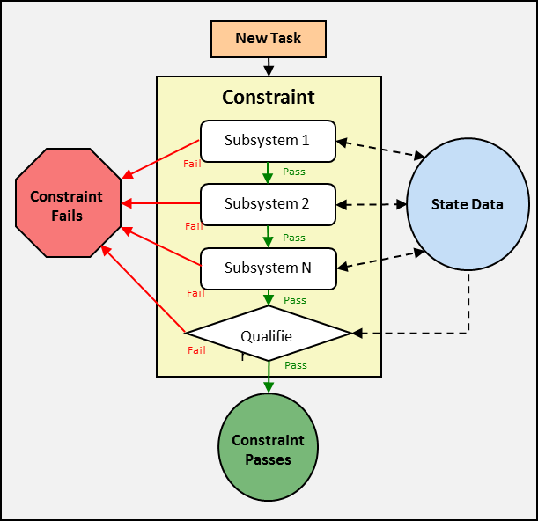
Constraints and State Transition
How state is propagated
Constraints represent requirements or what states should be
For each constraint, determine the states required to evaluate the constraint
Follow the tree that represents the system
Update the state along the way
Each subsystem calls the CanPerform() method to determine the state transition
The CanPerform() method what states can be
Notes:
Constraints – a limit on values of a system state variable
Dependency – describes the relationship between one or more subsystems
Asset – a collection of subsystems with some significant meaning to the modeling engineer

Slide 22
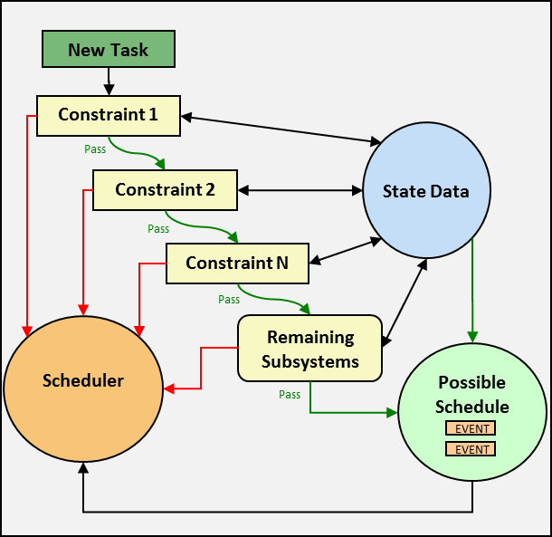
Check all the Constraints
Only Evaluate Subsystems Once
For all constraints, determine the state need to check the constraint
As all constraints are checked, the full state will be determined
If any subsystems are not used to check a constraint, evaluate remaining subsystems
Notes:
Constraints – a limit on values of a system state variable
Dependency – describes the relationship between one or more subsystems
Asset – a collection of subsystems with some significant meaning to the modeling engineer

Slide 23
Representing State
System State is stored as a “bulletin board”
As state data is generated, it is posted for others to access
Only change of state is stored (relative state)
All states point to their previous state (absolute state)
Power Subsystem
Watts
Time
Watts
300
0.5
1.5s
270
0.85
300
Watts Used
0.85s
500
1.5
270
0.5s
Intermediate Time
Other Subsystems
State Data Bulletin Board
Event Start
Event End

Slide 24
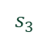
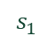
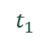
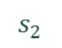
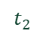
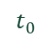
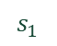
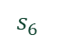
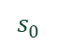
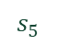
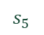
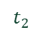
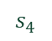
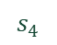
The Scheduler
$$t_{0}$$
$$t_{1}$$
$$t_{2}$$
$$t_{0}$$
$$t_{1}$$
$$t_{2}$$
$$s_{0}$$
A
B
C
$$s_{0}$$
A
B
C
$$s_{1}$$
C
A
C
$$s_{2}$$
C
$$s_{1}$$
$$s_{3}$$
B
$$s_{2}$$
B
C
$$s_{4}$$
$$s_{3}$$
A
B
Reference
$$s_{5}$$
B
$$s_{4}$$
A
$$s_{6}$$
C
$$s_{5}$$
B
Event C adds four more schedules but only five more elements in memory for a total of eight total items in memory, as opposed to 12 if all schedules were copied.
$$s_{6}$$
C

Slide 25
Summary
HSF has been used to simulate many scenarios
https://github.com/emehiel/Horizon/wiki/Academic-Documentation
Thermal Soaring
CubeSats
Sounding Rockets
UAV Swarm Search and Rescue
6U Space Telescope Constellation
Lunar Gateway Trajectory Analysis

